Slide 1
SI 501 F21: Week 2 Agenda
501 Hunt review
Discussion of readings
Communicating about challenges
Collaboration Plan
Initial client contact email
Discussion section

Slide 2
501 Hunt How did it go? Why did we do it? Comments?

Slide 3
Examples from 501 Hunt
005K – The JSR Collective
Jeremy Huang, Sharadhi Raghuraj, Stephanie Tong, Jerry Viena, Rebecca Xu
009I – DAUX Group
Roshan Chhetry, Vicky Huang, Caroline Sucher, Conan Wu
013J – Team Avalanche
Nina Chen, Vennie Dobrosavljevic, Joe Ortigara, Jiangxue Wang
015J – Team hUmanX
Aditya Mankare, Grace Song, Angelica Tome, Danni Xiao, Chao Xu

Slide 4
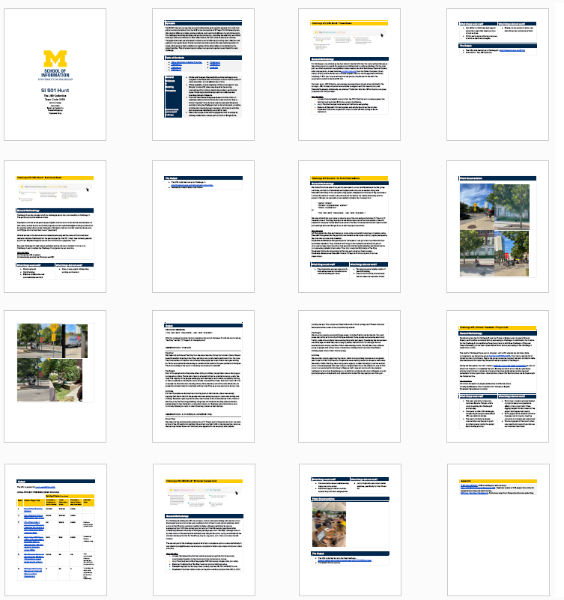
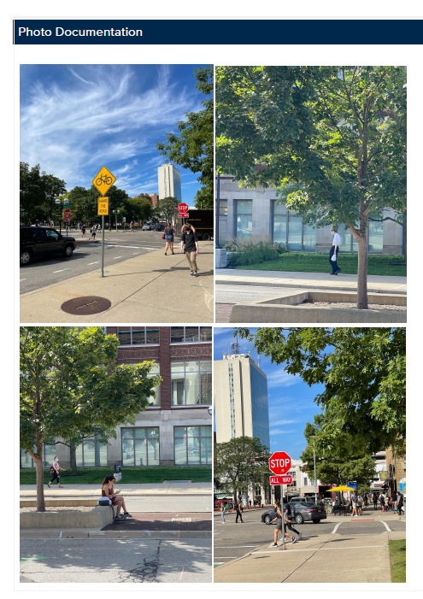
[005K] The JSR Collective– Thorough documentation! Jeremy Huang, Sharadhi Raghuraj, Stephanie Tong, Jerry Viena, Rebecca Xu

Slide 5
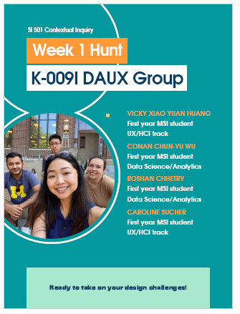
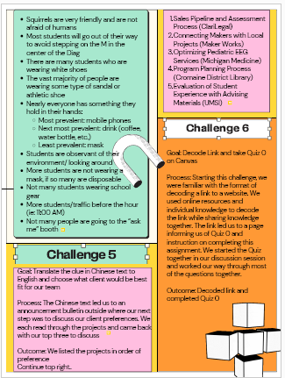
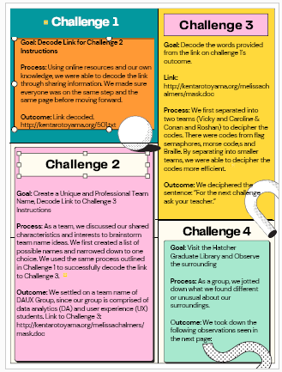
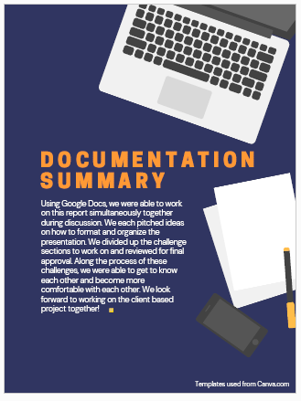
[009I] DAUX Group– Nice infographic! Roshan Chhetry, Vicky Huang, Caroline Sucher, Conan Wu

Slide 6
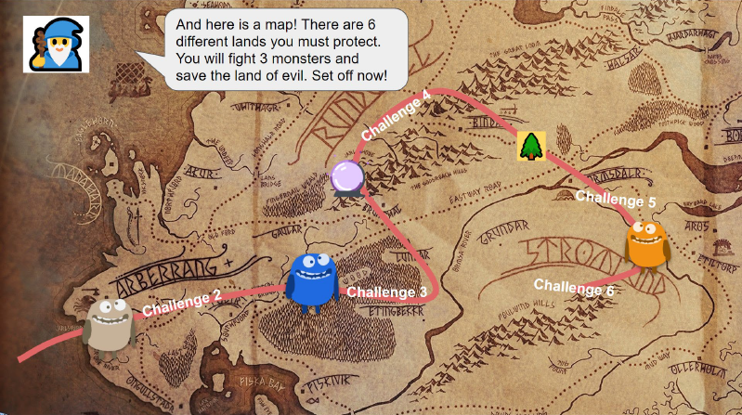
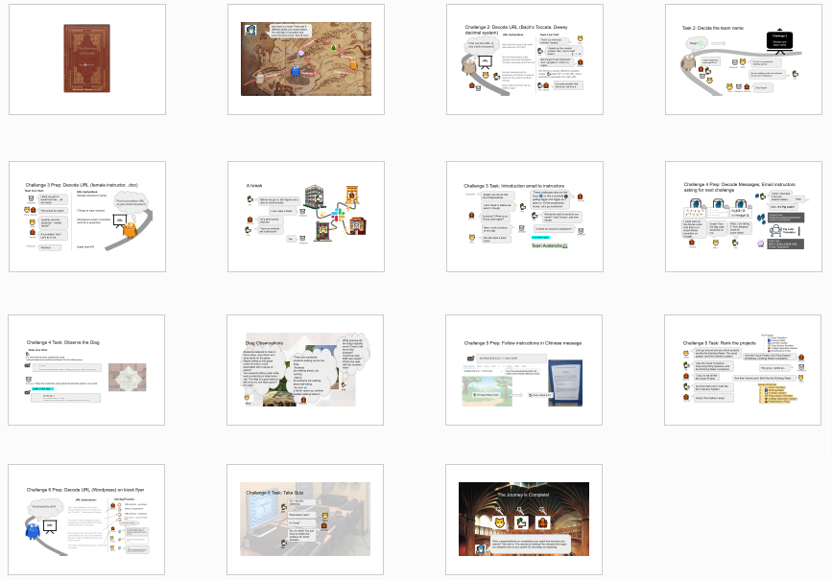
[013J] Team Avalanche – Creative game format! Nina Chen, Vennie Dobrosavljevic, Joe Ortigara, Jiangxue Wang

Slide 7
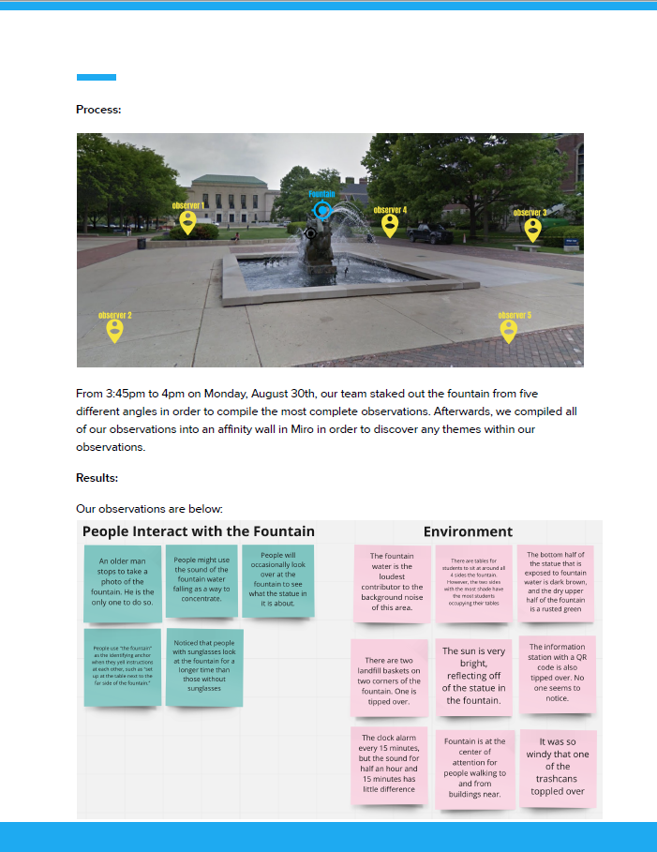
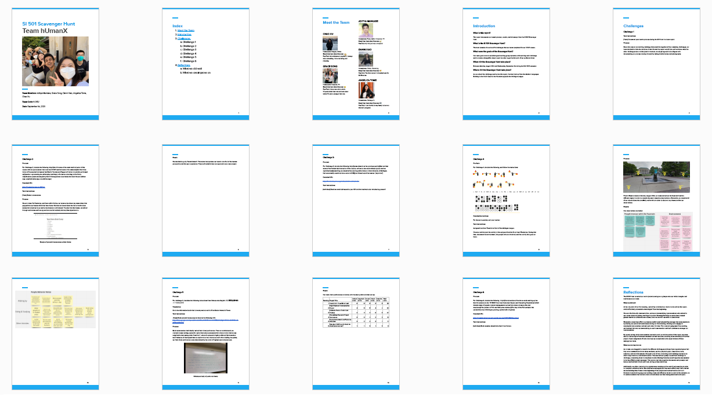
[015J] Team hUmanX – Head-start on SI 501 content! Aditya Mankare, Grace Song, Angelica Tome, Danni Xiao, Chao Xu

Slide 8
Team-client matches and client contact information at
http://j.mp/si501f21projXXX, where “XXX” is your 3-digit Discussion section number.
501 Hunt discussion with each team during team activities later today.

Slide 9
Discussion of Readings
What was the Tuckman (1965) paper about?
Tuckman described several stages of team formation. What are the four stages, and what happens in each?
What were the names he gave to the stages?
What do Barczak et al. (2010) mean by “team emotional intelligence”?
Barczak et al. discuss two kinds of trust in a team: affective trust and cognitive trust. What are these, and how do they differ?
What is the main conclusion of Barczak et al.’s research?
Why do you think you are assigned these readings?
Notes:
EI: ‘ability of a group to develop a set of norms that manage emotional processes’ (Druskat & Wolff, 2001b, p. 133)

Slide 10
Team Feedback from the 501 Hunt
What did your team do well?
“All members actively participated and we have formed a group on Discord to keep in contact.”
“Communicating and collaborating on solving problems.”
“The work is distributed equitably. Everyone is contributing based on their strengths while also learning from the rest of the team.”
“We mitigated disagreements over project ranking democratically, and completed the 501 hunt with no issues.”
What could your team do better?
“We could share the workload a bit better. We all did work for it but I think one person did a bit more than everyone.”
“I think we need a leader to help distribute the work to different people, so we can work more efficiently and without any task conflicts. ”
“Discussion did not have a lot of participation; there was a lot of silence.”
“We could communicate our expectations more concretely. ”

Slide 11
How can you communicate better with your teammates, or with your client, especially when there may be a problem?

Slide 12


“I” Statements for Effective Communication
Main claim: Most people want to help solve problems, but they aren’t always aware of the problem, especially if they have a role in it.
Use “I” statements which communicate the negative impact on you, without including a negative judgment of them.
Not magic, but better than alternatives.

Slide 13
Student comments about themselves…
What did you do well?
“I think I did well completing my assigned tasks and offering assistance and support to my teammates if they needed it.”
“Active participation in team work and also encouraging others to participate in the activity.”
“I think I did a good job articulating decisions that needed to be made.”
“I assumed a leadership position at certain points to help engage each of the group's members.”
What could you have done better?
“Be more punctual.”
“I think I could participate into discussion more actively.”
“I need to do better in trusting my team to do what they said they are going to do.”
“Sometimes during the Hunt I felt that I was jumping ahead without making sure my team was with me.”
“I felt like I was imposing my own experience on my team members as opposed to assisting them to come to conclusions on their own. I want to work on that in future meetings.”

Slide 14
“I” Statements for Effective Communication
Main claim: Most people want to help solve problems, but they aren’t always aware of the problem, especially if they have a role in it.
Use “I” statements which communicate the negative impact on you, without including a negative judgment of them.
Not magic, but better than alternatives.

Slide 15
What You Should NOT Do
“Please let other people have their say before you make your points. Don't talk so much!” (ORDERING, DIRECTING)
“lf you keep interrupting everyone in our meeting, you're going to have everyone mad at you.” (WARNING, THREATEN­ING)
“It is simple, common courtesy, to let people finish what they have to say before interrupting.” (MORALIZING, PREACHING)
“God gave us two ears and one mouth so we would listen twice as much as we talk.” (TEACHING, LECTURING)
“The next time we have a meeting, may I suggest you hold back until everyone else makes their contribution?” (ADVISING, OFFERING SOLUTIONS)
“You're really discourteous in our staff meetings.” (CRITI­CIZING, JUDGING)
“You're very bright and you always have good ideas, but how about giving others a chance to speak?” (PRAISING, BUT­TERING UP)
“You act like a know-it-all in our staff meetings.” (NAME-CALL­ING)
“I’m sure you can curb your habit of interrupting very easily.” (REASSURING)
“I think you're using our meetings to show off your vast experi­ence and knowledge.” (PSYCHOANALYZING)
“Why do you have to hog the discussion so much and interrupt everyone?” (PROBING, QUESTIONING)
“You're going to have to do something about your shyness in our meetings-we never hear your opinions.” (SARCASM, HUMOR)
Adapted from Gordon, Thomas. (2001). Leadership Effectiveness Training: The Proven Model for Helping Leaders Bring Out the Best in Their People, 35th Anniversary Edition. TarcherPerigee.

Slide 16
“I” (or “We”) Statements
State the problem in a factual, neutral way.
“You were late.” or “You have a habit of being late.”
“We have been waiting for 15 minutes to start this meeting.”
Mention its negative impact on you. (“I” statements)
“You made us waste time.”
“I lost time I could have spent on other assignments.”
Make a request, or open door to dialogue.
“Could you try to arrive on time in the future?”
“Should we reschedule our meetings so that we can all arrive on time?”

Slide 17
“I” Statements Practice
State the problem in a factual, neutral way.
Mention its impact on you.
Make a request, or open door to dialogue.
Situation 1: Your client keeps asking your team to do a project that is too big in scope.
Situation 2: Your teammate always comes late to team meetings.
Situation 3: Your teacher assigns pointless exercises to learn things you believe you already know how to do.

Slide 18
Individual Comments
“You were a good team member and helped a lot during the challenge.”
“I really think you have a superpower around getting things all done perfectly in a short time.”
“Thank you for your kindness right after we met each other. You were the person who kept our team together.”
“You were collaborative and communicated thoughts clearly.”
“Great job at leading the team!”
“I think you could improve by being more communicative.”
“I think that we teammates can share the workload with you to reduce your stress.”
“Speak up more on what you want!”
“Provide other team members with constructive feedback.”
“It would be great if you could sometimes slow down a bit.”

Slide 19
Collaboration Plan [In-Class Team Assignment]
Find document on Canvas (docx).
Read document, discuss among teammates, fill it out, and submit!
Feel free to work outside of the classroom, if you want, but if you go elsewhere, please write your team name and location on the whiteboard, so that we know where you are and can come visit.
Try to complete by end of Lecture, though you have until Wednesday.

Slide 20
Initial Client Contact Email [In-Class Team Assignment]

Slide 21
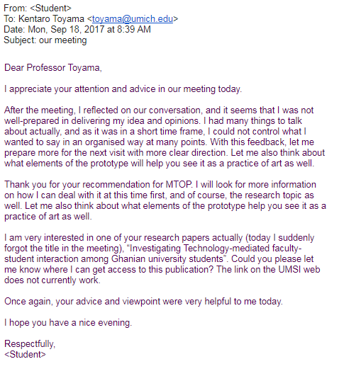

Slide 22
The #1 Secret to Effective Emails!
Keep the body of the message (before your signature) short and to the point. Focus on what you want the reader to learn or to do. Put the action you want the reader to take as early as possible in the mail, though of course you have to provide any critical context.
Put all the remaining details below your signature.
The art is in…
Deciding what belongs in the body and what are “details.”
Transmitting your intention clearly, but with the fewest words.
Ordering the content in the body, so that the recipient can make decisions quickly – Do they need to read this mail? Do they need to respond? How soon do they need to respond?
In general, put information that allows the recipient to decide as early in the message as possible… but no earlier. The action you’re requesting might require context they need to understand to take the action.
Making the subject line clear about what is expected from the reader.

Slide 23
Initial Client Contact Email [In-Class Team Assignment]
Find assignment document on Canvas (docx).
Toward the end of the document, there are tips for your first client contact meeting.
Read the whole document, discuss among teammates, and write a draft of your first client contact email!
Send and submit, CC’ing your GSI, if you finish. (If you forget to CC your GSI, it’s OK. Just forward what you sent to them, so that they know you did it.)
Finalize, send, and submit by Wednesday. Don’t forget to CC your GSI.

Slide 24
Discussion of Readings
According to the SI 501 Overview document, what are the key skills you will be learning in this course?
According to Holtzblatt et al. (2005), what is a “work group”?
According to Holtzblatt et al., what is a “job role”?
Notes:
EI: ‘ability of a group to develop a set of norms that manage emotional processes’ (Druskat & Wolff, 2001b, p. 133)

Slide 25
Tips for Initial Client Meeting
What’s a good time frame for the initial meeting?
This week or next week (Sept. 13-24).
As late as Oct. 8 is OK but not good.
Where should it be held?
Ideally, in person in their offices.
Zoom is OK if they wish, or you wish.
What should you expect to discuss in the first client meeting?
Scoping – problem should be neither too large nor too small.
Interview participants – at least 3 job roles.
Other tips are in the assignment. Read it today! Feel free to take them with you.
How many meetings should you expect with the client?
1 with the primary contact at the beginning [required]
6-12 interviews/observations with different people (Oct. 4-Nov. 5) [required]
1-2 secondary interviews to fill gaps, get feedback (Oct. 25-Nov. 12). [optional]
1 with your primary contact to preview your findings/recommendations. (Nov. 15-Nov. 24) [optional, but strongly recommended]
1 to present your findings to the client (likely a group presentation in December) [optional for course, but might be required by client]

Slide 26
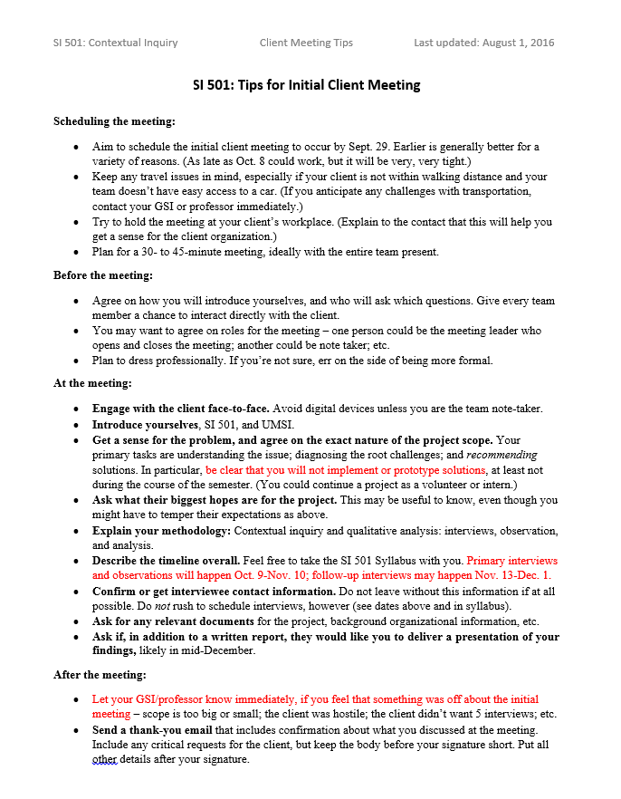
In Canvas, as part of the Client Email assignment document →

Slide 27
Any questions about the assignments or about the first client meeting?

Slide 28
Due before Lecture today…
Readings for this week.
Quiz 1.
Team feedback for the 501 Hunt: http://j.mp/si501f21tf . Complete as much as you can, even if you don’t have all of your teammates’ UMIDs.
It’s still not too late to complete these, if you haven’t – please do it by today.

Slide 29
For next week!
Make sure to send out client emails by Wednesday, with your GSI on CC. (And submit mail on Canvas.)
Read Webster & Watson (2002), Dowell & Carter (2011), and the Background Research Report assignment.
Take Quiz 2.
Bring any questions about the Background Research Report to class next week.

Slide 30
For the remainder of Lecture and Discussion this week, work on the assignments with your team. You can stay in this room or go elsewhere to work. Instructor and GSIs will stay in the room to answer questions until 10:50am. You do not need to return to this room for Lecture today. (But, be sure to go to Discussion!)

Slide 31
Today’s Discussion Section
GSIs will visit each team to check in. Please go to Discussion section.
Complete Collaboration Plan.
Complete Initial Client Contact Email, send it to your client with your GSI on CC.
If you complete the Collaboration Plan and send out the client contact email (remember to CC your GSI), you can leave early.

